Slide 1
The MIPS Processor

Slide 2
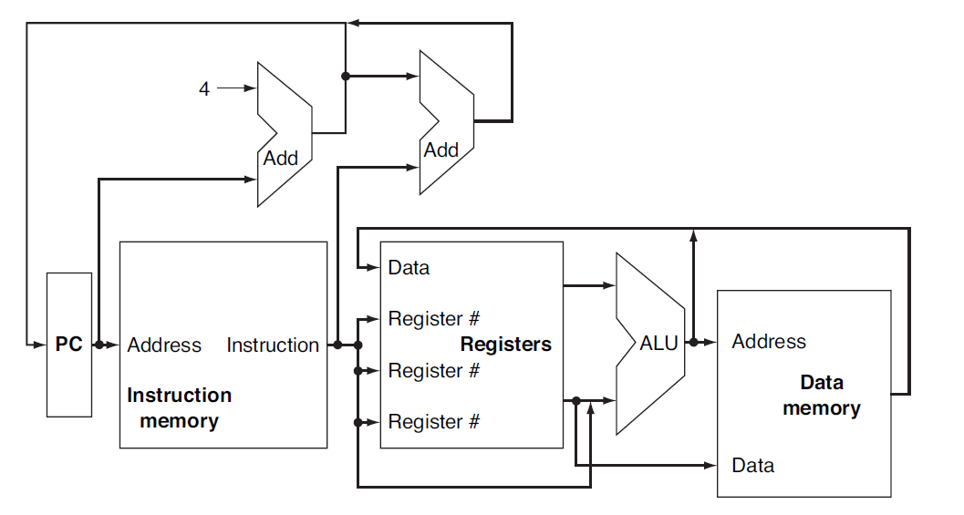
Basic Datapath

Slide 3
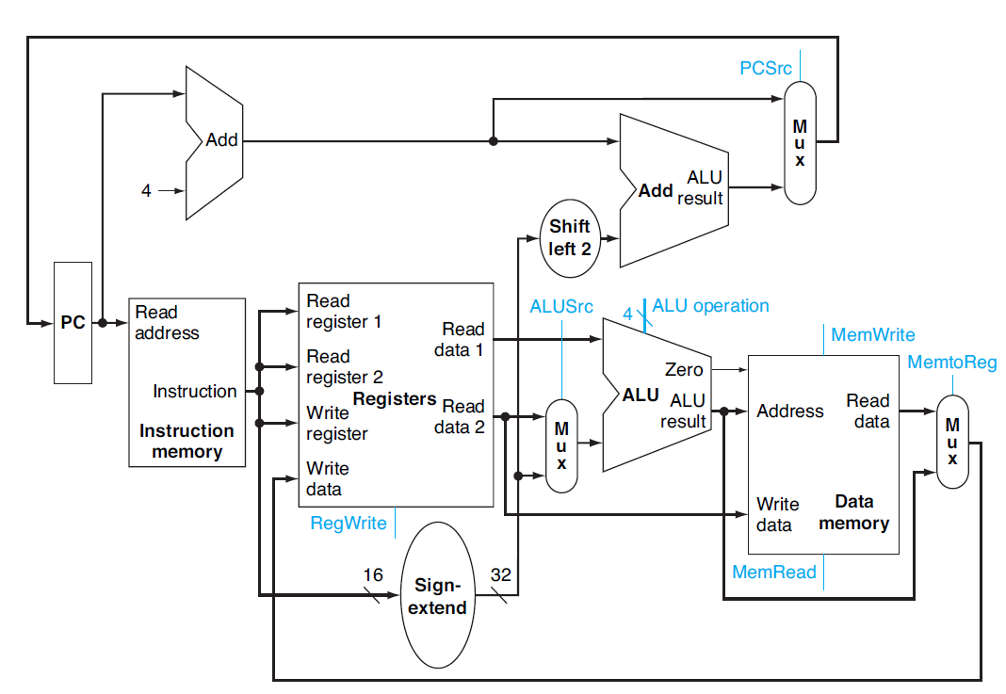
Control Pins

Slide 4
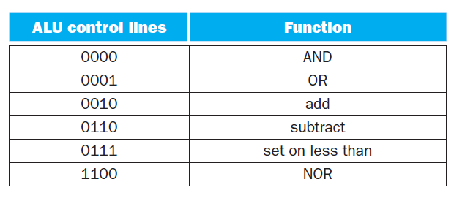
ALU Control pins

Slide 5
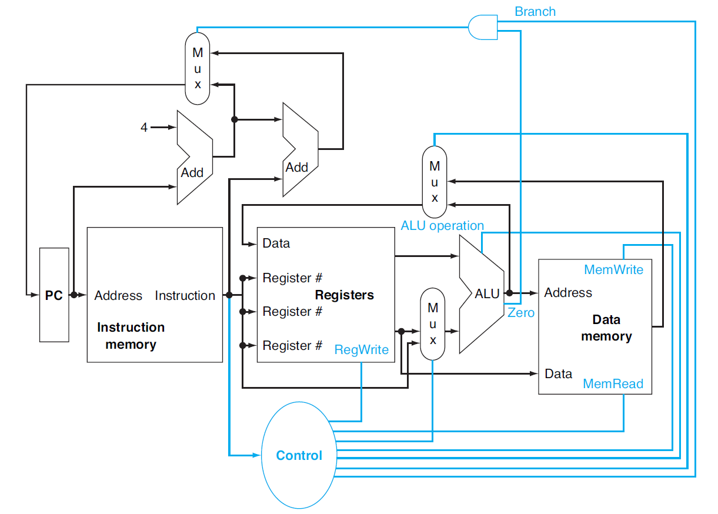
Datapath with Control

Slide 6
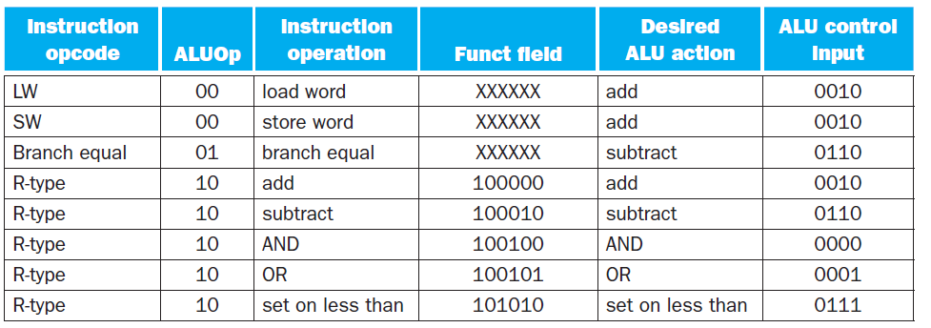
ALU Control

Slide 7
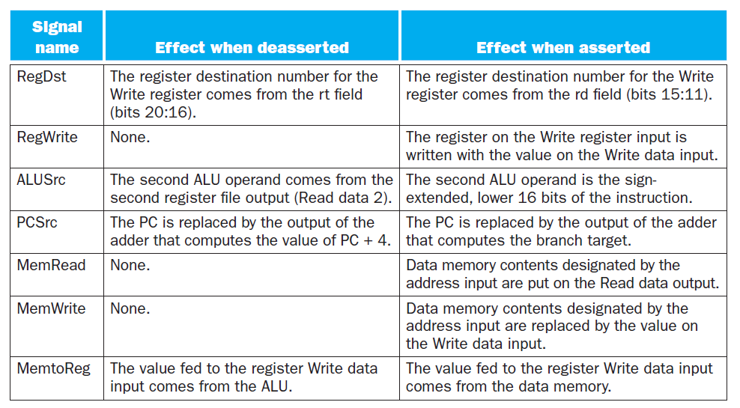
Control pins

Slide 8
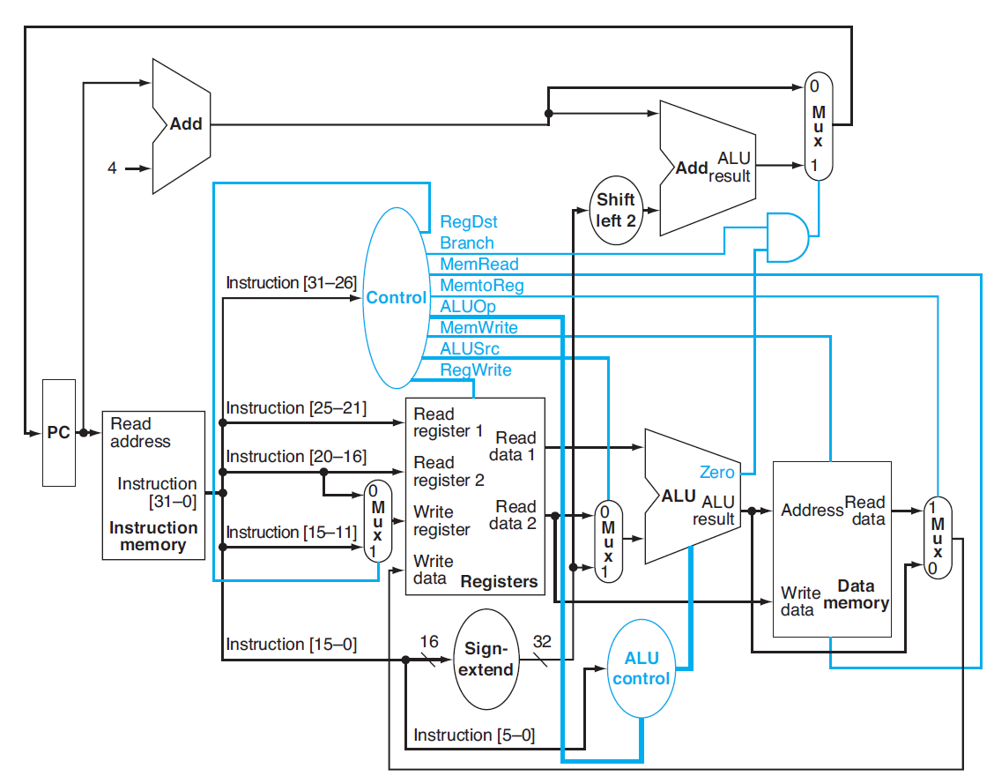
Datapath with ALU Control

Slide 9
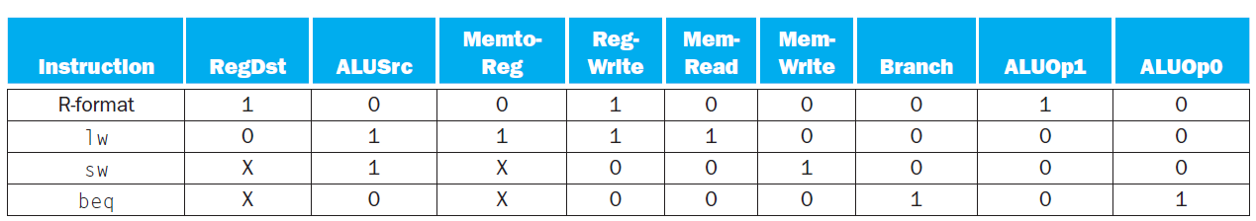
Control Pin Values

Slide 10
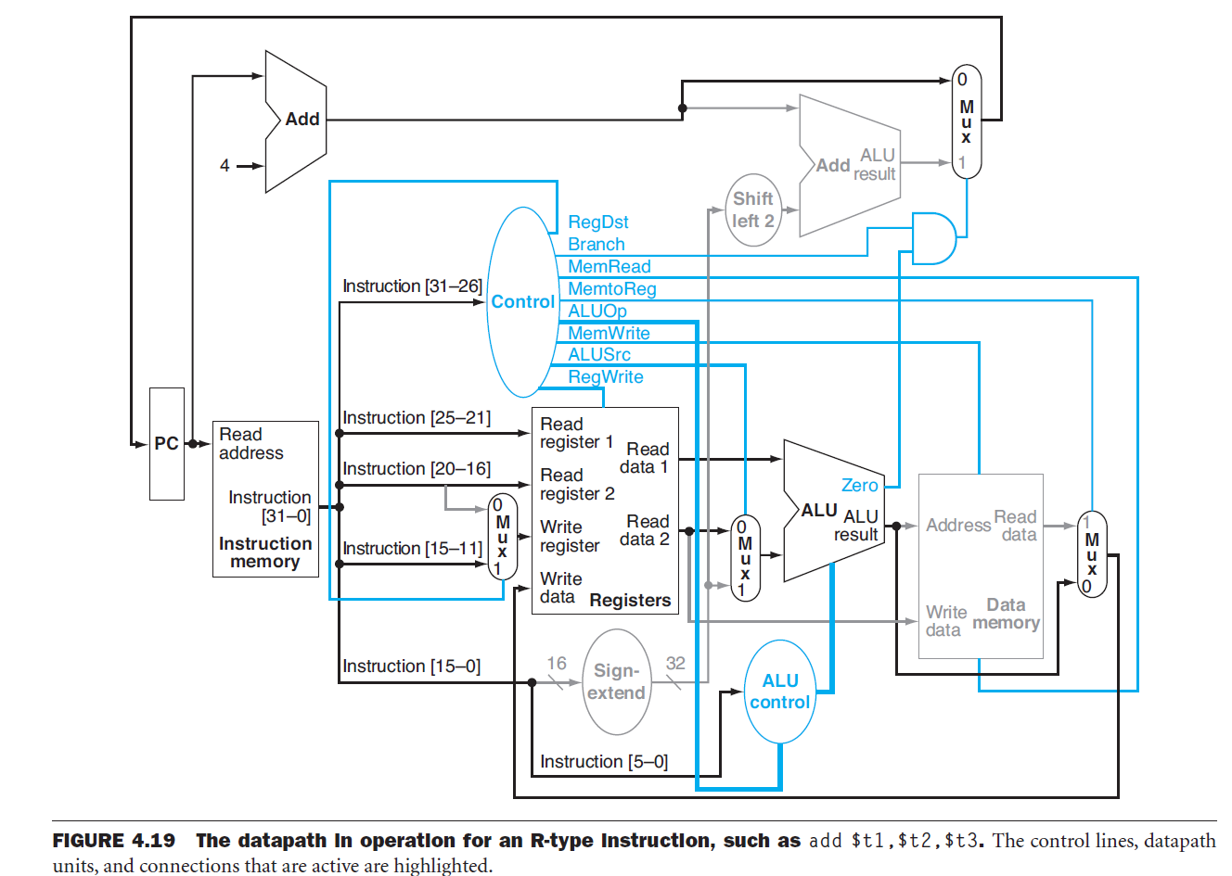
Datapath executing R-type instructions

Slide 11
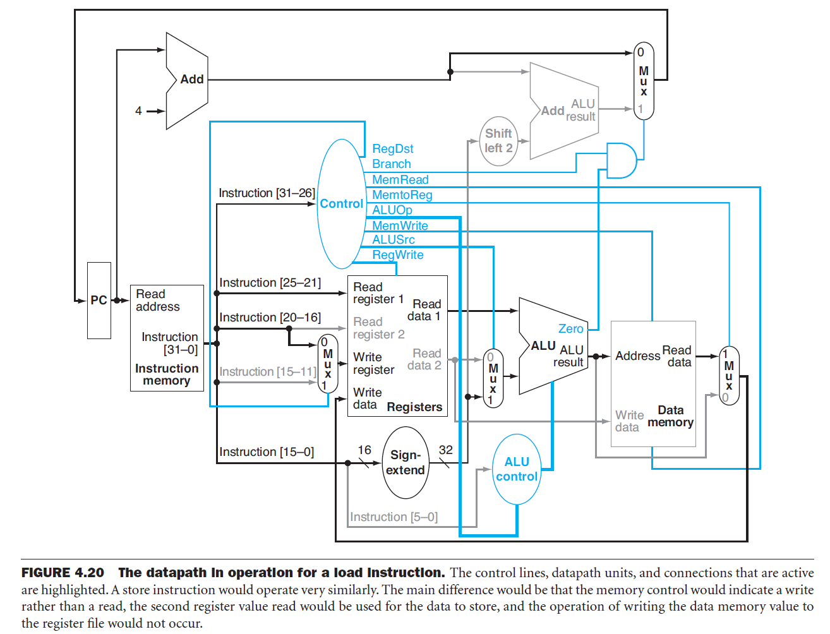
Datapath executing Load instructions

Slide 12
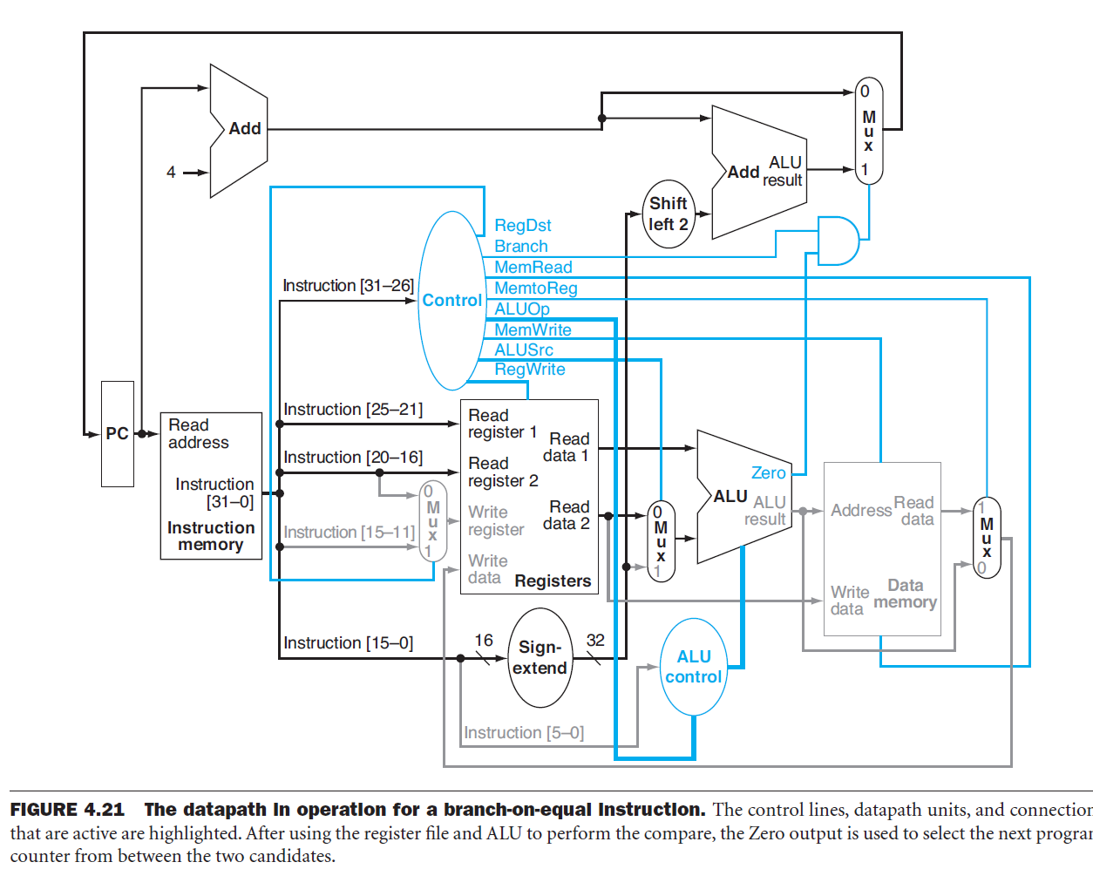
Datapath executing branch instructions

Slide 13
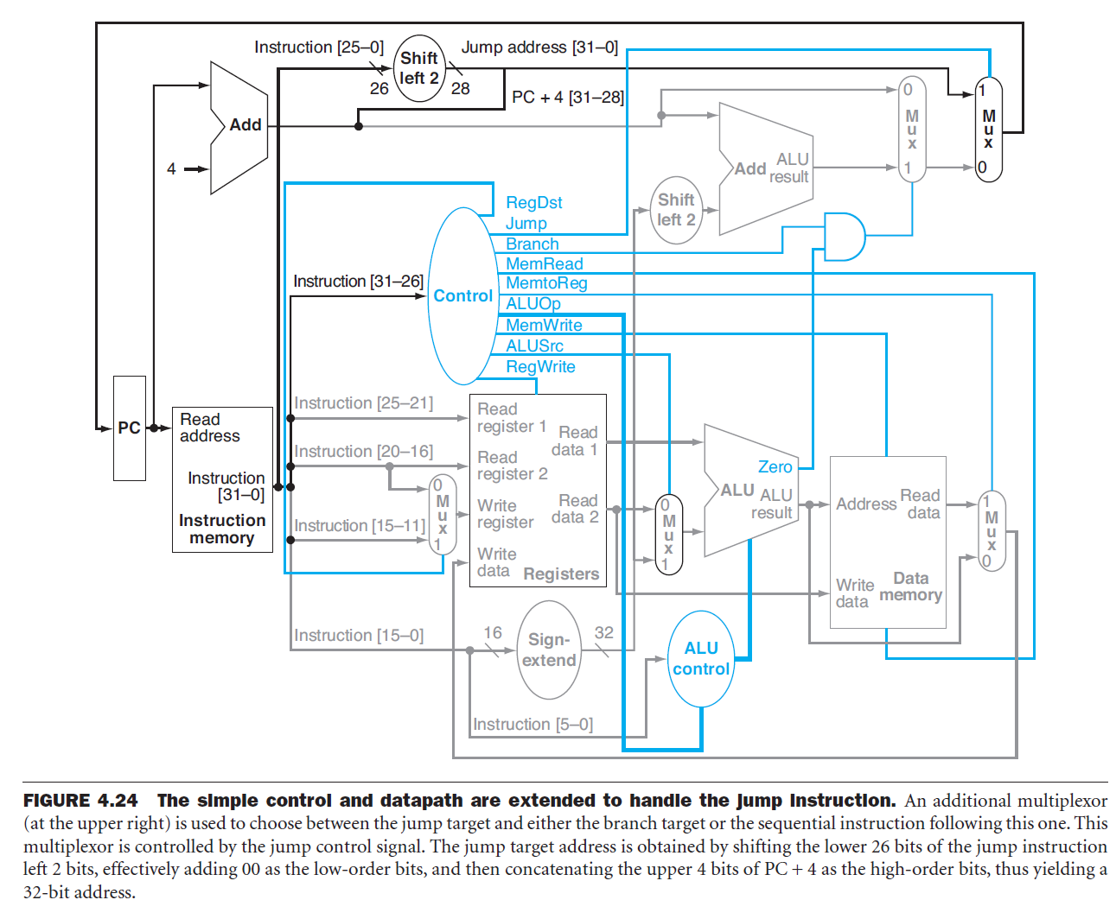
Jump instruction implementation

Slide 14
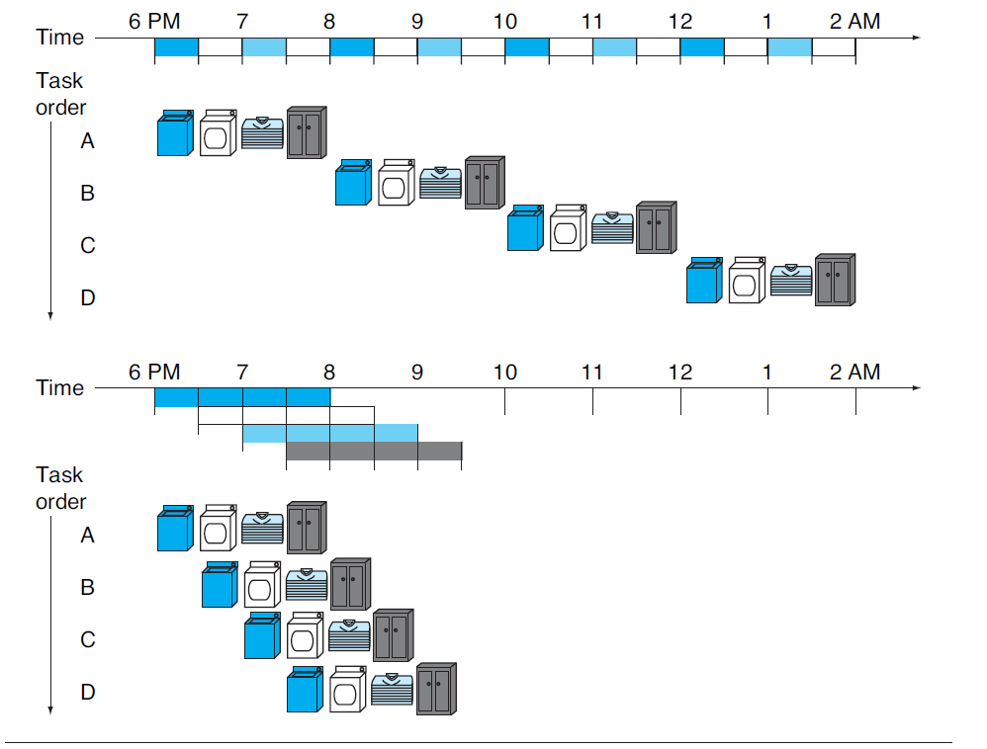
Pipelining Concept

Slide 15
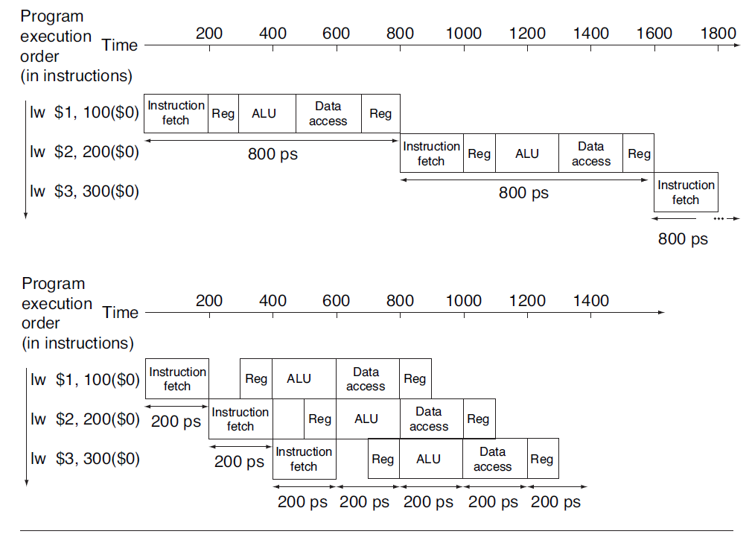
MIPS Pipelining

Slide 16
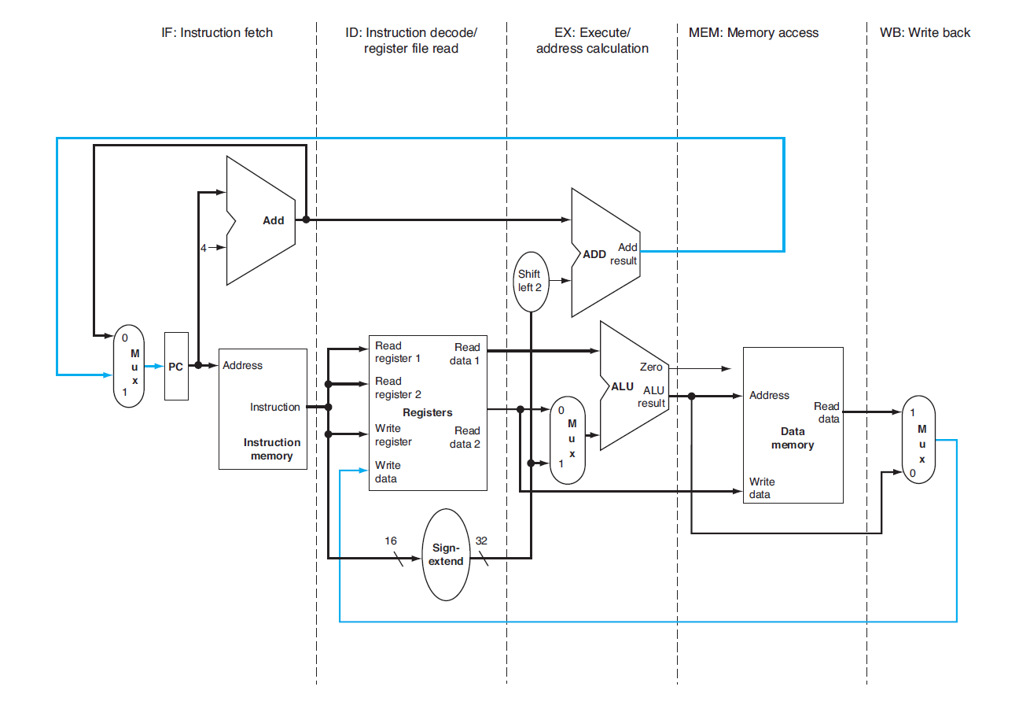
Breaking up the datapath

Slide 17
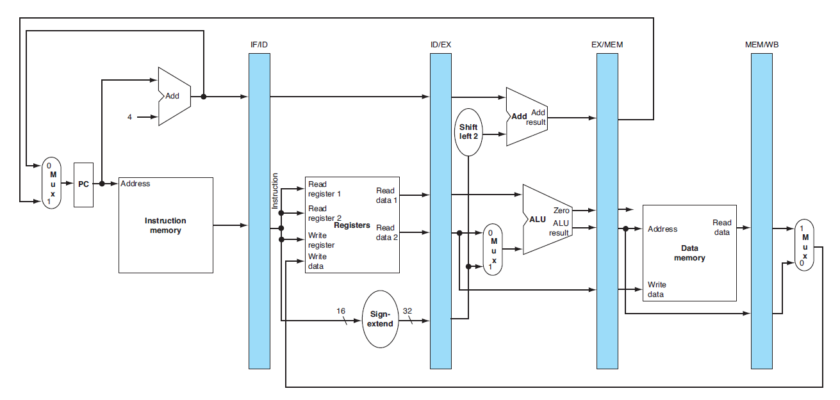
Adding memory buffers

Slide 18
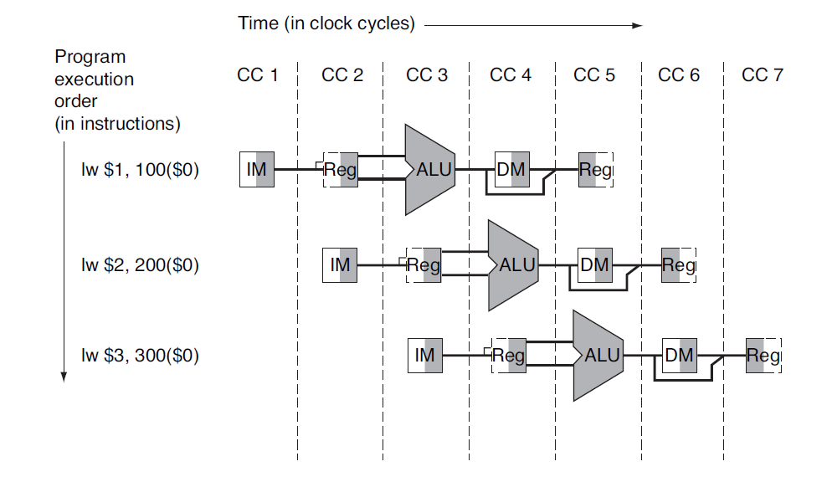
Datapath during execution of instructions

Slide 19
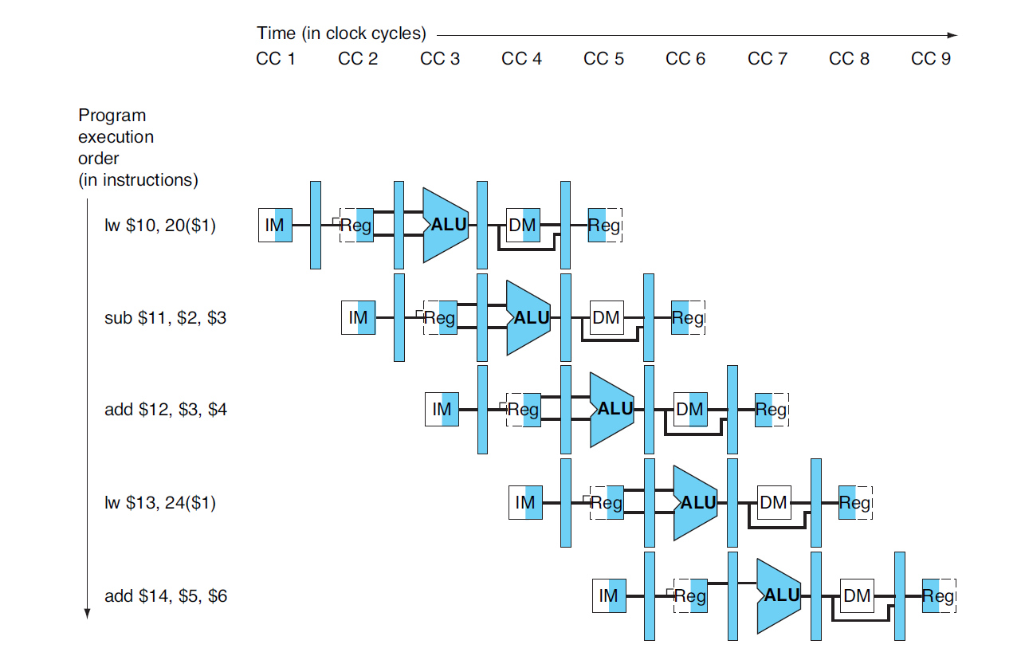
Datapath during execution of instructions

Slide 20
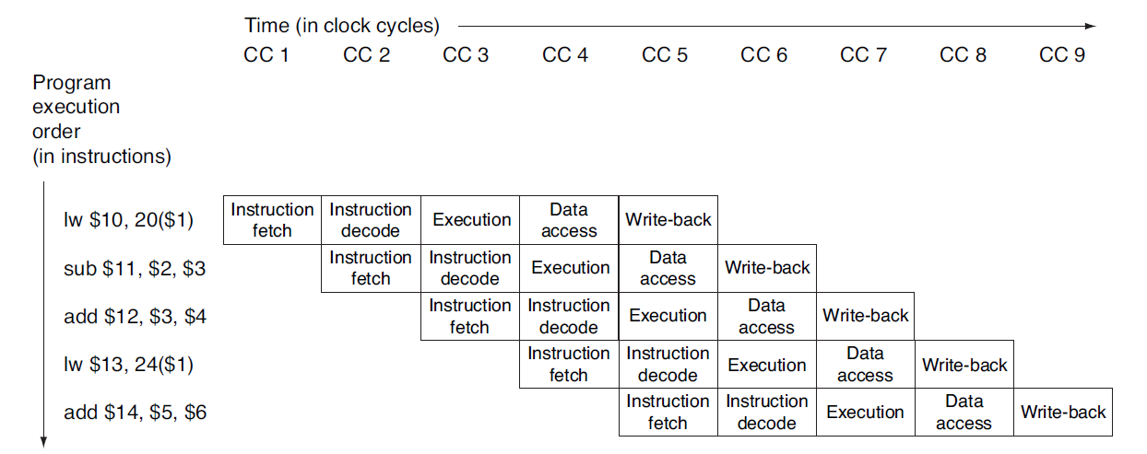
Datapath during execution of instructions

Slide 21
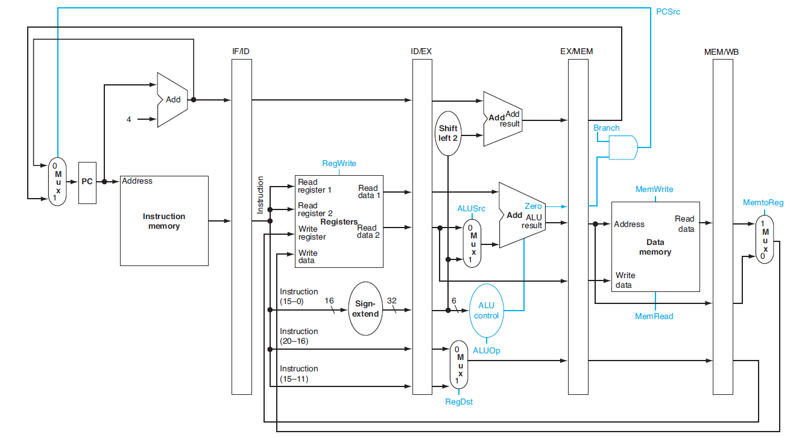
Pipeline control pins

Slide 22
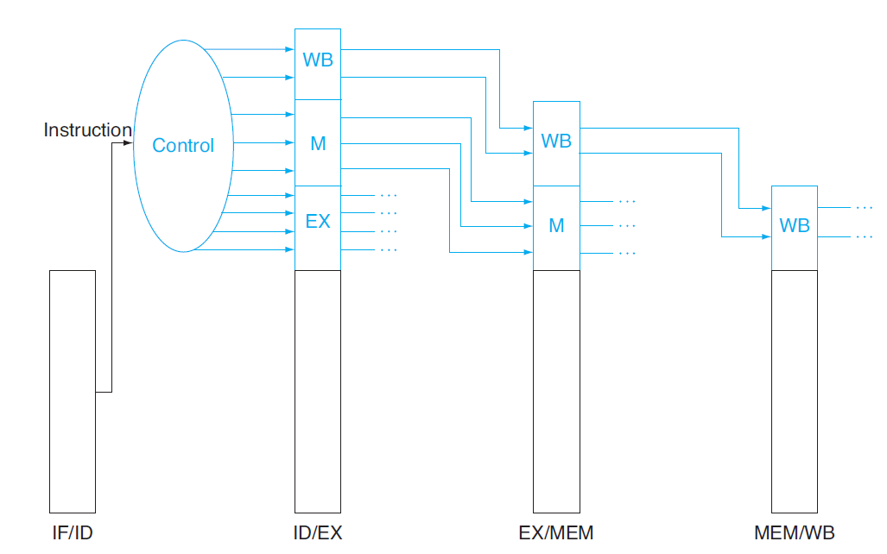
Pipeline Control

Slide 23
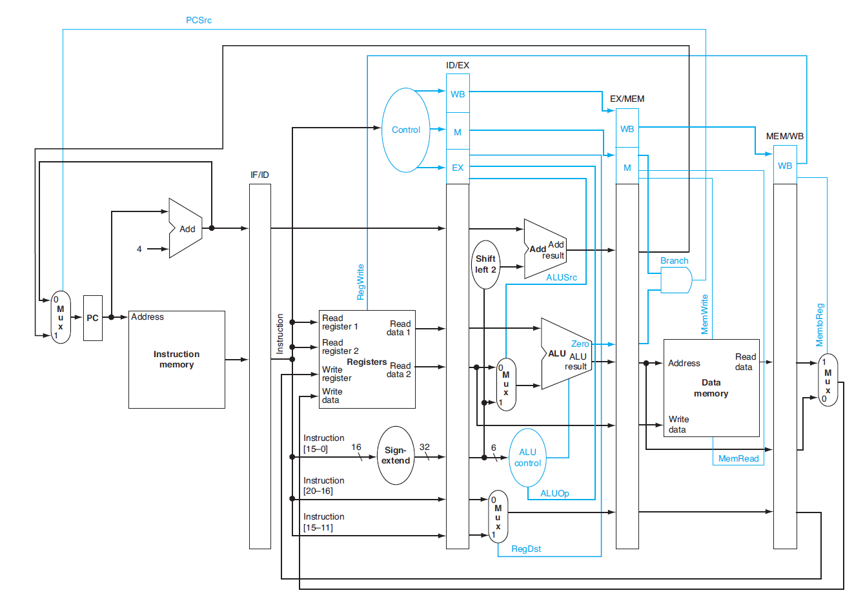
Pipelined datapath

Slide 24


